Slide 1
APT2022-INTRODUCTION TO ASSEMBLY LANGUAGE PROGRAMMING
Objectives :
To learn EMU8086 installation and familiarize with EMU8086 environment
To learn how to:
•Assemble instructions into the memory of 8086 using Emu8086
•Use Emu8086 to execute instructions
•Run opt-in programs in EMU8086
•Write a complete assembly program.
•Edit an existing source program. 24

Slide 2
Part I: Introduction to Emu8086
An Integrated Development Environment (IDE) provides a convenient environment to write a source file, assemble and link it to a -.COM or -.EXE file, and trace it in both source file and machine code. Emu86 is an educational IDE for assembly program development.
You can download the latest student version of EMU86 from the web page www.emu8086.com.
It is a Windows program, and will run by dragging an -.ASM, -.OBJ, -.LST, -.EXE , or -.COM file into the emu86 shortcut icon.
By this action, asm or lst files will start the 8086 assembler source editor, while obj and exe files starts the disassembler and debugger units.

Slide 3
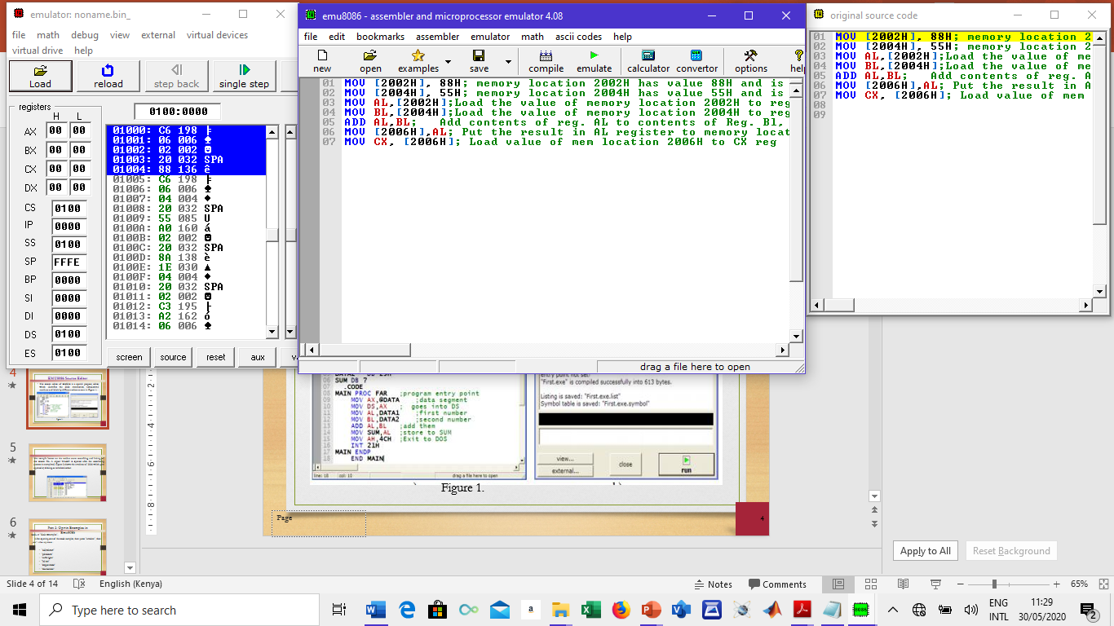
EMU8086 Source Editor
The source editor of EMU86 is a special purpose editor which identifies the 8086 mnemonics, hexadecimal numbers and labels by different colors as seen in Figure 1.
Figure 1.

Slide 4
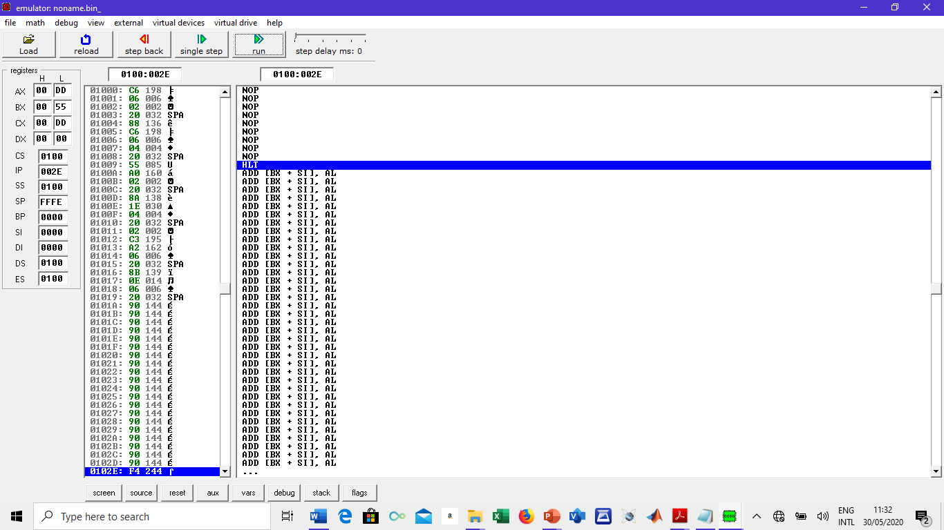
EMU8086 Report Window
The compile button on the taskbar starts assembling and linking of the source file.
A report window is opened after the assembling process is completed.
Figure 2 shows the emulator of 8086 which gets opened by clicking on emulate button.
Figure 2

Slide 5
Part 2: Opt-in Examples in Emu8086
Look at “Code Examples‟.
After opening one of the code samples, then press “emulate”, then, “run”. Also try these :
“add/subtract‟
“palindrome‟
“traffic lights‟
“led test‟
“stepper motor‟
“thermometer‟

Slide 6
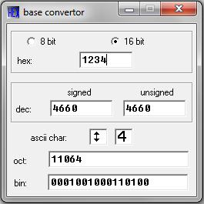
Part 3: Assemble and execute instructions in Emu8086
Use emu8086 to make the calculations following:
a) 10101101b = ?
b) 17h = ?
c) 59 = ? h
Procedure:
Choose “Math” and specify “Base Convertor” in emu8086.
Enter one of the numbers like in the Figure 3
Figure 3

Slide 7
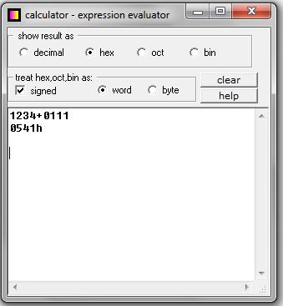
Use EMU8086 to evaluate an expressions
Evaluate : 0FFFFh *12h +0FFFFh
Procedure:
1. Choose “Math” and specify “Multi Base Calculator” in emu8086.
2. Enter the expression like in the Figure 4.
Figure 4.

Slide 8
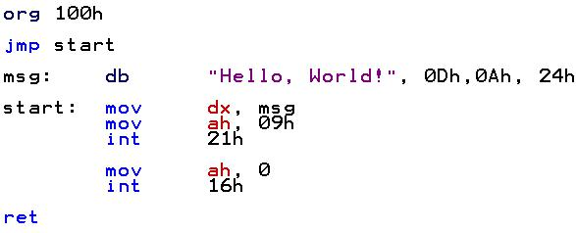
Part 4: Writing and Running Assembly Code in Emu8086
In this part, we are entering Assembly language world.
Let’s say “Hello, World”

Slide 9
Part 4: Writing and Running Assembly Code in Emu8086
Write the following assembly language program in Emu8086

Slide 10
Part 4: Writing and Running Assembly Code in Emu8086
After executing the assembly language program in 8086 emulator, provide and explain its view in the following: stack, variables, memory, 8086 machine code listing, registers and the ALU contents.
Choose other two 16-bit numbers of your own,
add the two numbers and repeat step 1.
Subtract the two numbers and repeat step 1.

Slide 11
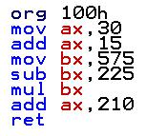
Part 5: Exercise Part
Exercise - 1
Calculate : (30 ₁₀ + 15 ₁₀ ) * ( 575 ₁₀ – 225 ₁₀ ) + 210
1. Choose “New” and specify “COM template” in emu8086.
2. Enter the following code to the editor:

Slide 12
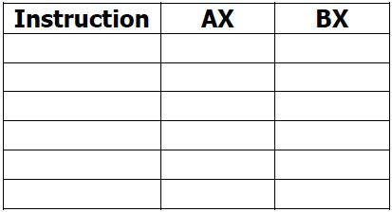
Part 5: Exercise Part
Exercise - 1
3.“ Start emulation by clicking the “emulate” button on the toolbar. A new emulator window will appear.
4. Single-step the program codes by pressing the “single step” button on the toolbar of the emulator window.
Table 1
5. Each time after pressing the “single step” button, check and record down the contents of AX and BX registers in Table 1
ADD AX, 15;
001E
0000
MOV BX, 575
002D
0000
SUB BX, 225;
002D
023F
MUL BX;
002D
015E
ADD AX, 210;
3D86
015E
MOV AX, 30;
0000
0000

Slide 13
Exercise - 2
Part 5: Exercise Part
In this example, we will develop a program to perform the following arithmetic operations:
14 ₁₀ * ( 233₁₀ – 125 ₁₀ ) + 227
Procedure:
1. Develop an assembly language program to perform the above arithmetic operations by only using registers AX and BX (write the program in Table 2).

Slide 14
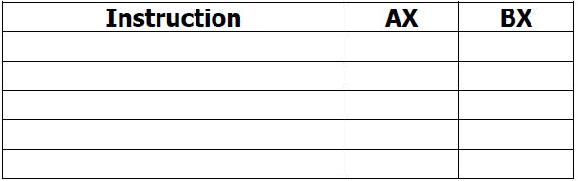
Exercise - 2
Part 5: Exercise Part
Procedure:
2. Write the program who does the calculation above into the assembler editor in EMU8086
3. Emulate the program by pressing the “emulate” button on the toolbar.
4. In the emulator window, single-step the program codes by pressing the “single step” button on the toolbar.
5. Each time after single-stepping, observe and record down the contents of AX and BX registers in Table 2.
Table 2
6. Using a calculator, calculate the answer for the above arithmetic operations: ……………..
Is it the same as the final answer in the AX register? …………YES……………………….…”
1739

